Slide 1
ITEC 101 FUNDAMENTALS OF IT
DANIEL OBUOBI, DCSIT,CU
DEVELOPMENT & HISTORY OF COMPUTERS

Slide 2
INTRODUCTION
Prehistoric
schemes for computation based specific arrangements of pebbles.
formalized 1000 years ago with the invention of the abacus.
Odometer-like device described in 100 AD -could be driven automatically and count in digital form.
Mechanical devices for digital computation appear to have actually been built in 1600s.
Much more widely known were the machines built in the
1640s by Blaise Pascal for doing + on numbers with 5 or so digits
and in the 1670s by Gottfried Leibniz for doing multiplication, division and square roots.
mechanical calculators were in very widespread use from the late 1800s until about 1970
In the mid-1800s, following the ideas of Charles Babbage, difference engines were used to automatically compute and print tables of values of polynomials.

Slide 3
INTRODUCTION CONT.
Analog Computers
In parallel with the development of devices for digital computation, various so-called analog computers were also built that used continuous physical processes to in effect perform computations.
harmonic analyzer, in which an assembly of disks were used to sum trigonometric series and thus to predict tides.
And in the 1930s, electrical analog computers began to be produced, and remained in widespread use for finding approximate solutions to differential equations until the late 1960s.
The types of machines discussed so far all have the feature that they have to be physically rearranged or rewired in order to perform different calculations.
The idea of a programmable machine already emerged around 1800, first with player pianos, and then with Marie Jacquard’s invention of an automatic loom which used punched cards to determine its weaving patterns.

Slide 4
INTRODUCTION CONT.
In the 1830s, Charles Babbage an analytical engine, which, if built, would perform sequences of arithmetic operations under punched card control.
From the end of the 1800s tabulating machines based on punched cards became widely used for commercial and government data processing.
Initially, these machines were purely mechanical, but by the 1930s, most were electromechanical, and had units for carrying out basic arithmetic operations.
Some of the machine were Harvard Mark I (by Howard Aiken in 1937-44), ABC,
The first large-scale system was the ENIAC, built between 1943 and 1946. which focus on numerical computation, originally for creating ballistics tables.
All the systems mentioned so far had the feature that they performed operations in what was essentially a fixed sequence.
In the late 1940s John von Neumann paper brought the idea of jumping around instead following a fixed sequence and stored program concept.
This opened the way for a lot of programs to be written.

Slide 5
HISTORY – COMPUTERS etc…
1936 Konrad Zuse - Z1 Computer
First freely programmable computer.
1942 John Atanasoff & Clifford Berry - ABC
The ABC computer
1944 Howard Aiken & Grace Hopper Harvard Mark I
The Harvard Mark 1 computer.
1946 John P. Eckert & John W. Mauchly ENIAC 1
20,000 vacuum tubes later...
1947/48 John Bardeen, Walter Brattain & Wiliam Shockley The Transistor
A transistor is not a computer
1951 John Presper Eckert & John W. Mauchly UNIVAC - First commercial computer

Slide 6
HISTORY - COMPUTERS etc…
1953 International Business Machines IBM 701 EDPM (IBM enters into 'The History of Computers‘).
1954 John Backus & IBM FORTRAN Programming The first successful high level programming lang.
1955(In Use 1959) Stanford Res. Institute, Bank of America, General Electric ERMA and MICR
The first bank industry computer - also MICR
1958 Jack Kilby & Robert Noyce IC 'The Chip'
1962 Steve Russell & MIT Spacewar PC Game
1964 Douglas Engelbart Mouse & Windows
1969 ARPAnet The original Internet.
1970 Intel 1103 Computer Memory - 1st dynamic RAM chip
1971 Faggin, Hoff & Mazor Intel 4004 Computer Microprocessor (The first microprocessor)

Slide 7
HISTORY - COMPUTERS etc…
1971 Alan Shugart &IBM The "Floppy" Disk
1973 Robert Metcalfe & Xerox The Ethernet Computer Networking
1974/75 Scelbi & Mark-8 Altair & IBM 5100 Computers - first consumer PC
1976/77 Apple I, II & TRS-80 & Commodore Pet Computers – consumer PC
1978 Dan Bricklin & Bob Frankston VisiCalc Spreadsheet Software
Any product that pays for itself in two weeks is a surefire winner.
1979 Seymour Rubenstein & Rob Barnaby WordStar Software
1985 Microsoft Windows - Microsoft begins the friendly war with Apple.

Slide 8
HISTORY - COMPUTERS etc..
1981 IBM The IBM PC - Home Computer
From an "Acorn" grows a PC revolution
1981 Microsoft MS-DOS Computer OS
From "Quick And Dirty" comes the operating system of the century.
1983 Apple Lisa Computer
GUI, graphical user interface.
1984 Apple Macintosh Computer
more affordable home computer with a GUI.

Slide 9
The Chronological Development of PC
1973
The first microcomputer kits based on the 8008 chip were developed
Intel introduced the 8080 microprocessor, was 10 times faster than 8008 chip and addressed 64 KB of memory.
1975
MITS introduced the Altair kit comprising of a power supply, front panel with a large number of lights, and 256 bytes of memory
Altair kit included open architecture system bus meaning anybody could build boards to fit in these slots and interface to the system
This encouraged companies to write programs including CP/M (Control Program for Microprocessors) and Microsoft BASIC (Beginners all-purpose symbolic instruction code
IBM introduced its first personal computer – Model 5100 comprising 16KB memory, built-in16-line-by-64-character display, a BASIC language interpreter and a built-in DC-300 cartridge tape drive for storage.

Slide 10
The Chronological Development II
1976
Apple Computer introduced Apple I, consisting of a main circuit board screwed to a piece of plywood.
1977
Apple Computer introduced Apple II, which helped set the standard for nearly all the important microcomputers to follow, including IBM PC.
1980
Apple (Closed architecture) Vs. Altair progressions (Open architecture)
In early 1980, IBM introduces the System/23 DataMaster, a small office computer system, which later becomes the direct predecessor of the IBM PC
In late 1980 IBM emerged as a leader offering personal computer with open architecture, slots for expansion, a modular design, and healthy support from both hardware and software companies other than IBM.

Slide 11
The Chronological Development III
1980
As a result, several parts of the PC were copied from the DataMaster design. It had the display and keyboard as external units.
Intel 8088 CPU was used because it offered 1MB memory address limit and an internal 16-bit data bus, but only an 8-bit external data bus.
1981
A new standard was established in the microcomputer industry with the debut of the IBM PC
IBM contracts out the PC’s languages and operating system to a (then) small company named Microsoft after CP/M rejected the contract. The rest is history!

Slide 12
Moore’s Law
The original IBM PC has come a long way in terms of advancement. For example
Processing capacity from 4.77MHz (8088) to 1.5 GHz or faster Pentium IV 12,000 times faster than the original IBM PC.
Storage from a few Kilobytes to 80 or more Gigabytes.
In 1965, the cofounder of Intel, Gordon Moore forecasted that the processor complexity would double every 18 months, true for the past 30 years and is widely referred in the industry as ‘Moore’s law’.
The law holds true for memory chips, processing power, and storage capacity.
IBM did not copyright its architecture rather outsourced development of some of the core components of the system software – BIOS (basic input/output system) and operating system enabling other companies to license and build their PCs.
the open architecture and outsourcing strategy, implemented by IBM, over the years led to creation of new opportunities in the market in the field of hardware and software development. The result of Intel and Microsoft

Slide 13
CLASSIFICATIONS OF COMPUTERS
Computers can be classified
by purpose,
by size/capacity and
by type.

Slide 14
Classification by Purpose
Depending on the flexibility of operations or ease of adaptability, computers are divided into
special or
general purpose
Special Purpose Computers are designed to perform a task or restricted number of tasks. For example
military operations
control device in industries that process steel or chemicals, Robots, Automobile
Many home appliances such as refrigerators, TVs, heaters and microwave ovens contain small computers
Most cameras have device that controls the shutter amount of light reaching the film.

Slide 15
Functions of special purpose computers
Functions perform are:
Monitoring and controlling the operation of a nuclear power plant, oil refinery or steel plant.
Controlling a military weapon system.
Regulating city traffic control operations.
Directing operations of spacecraft, airplanes, tankers, ship submarines.
Managing manufacturing machinery.
Operating hospital procedures such as CT scanners
Navigational system of an atomic submarine

Slide 16
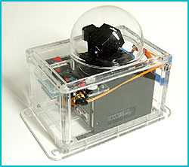
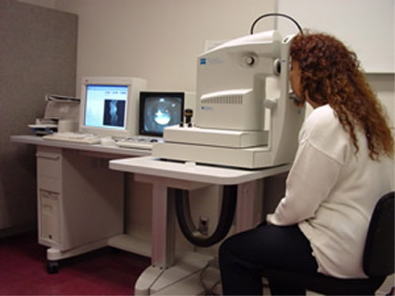
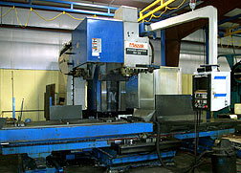
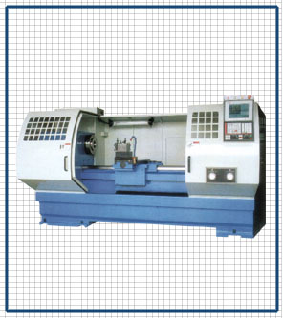
Some special purpose computers

Slide 17
General Purpose Computers
Designed to solve a wide range of problems.
They can perform any task required simply by changing the application program stored in their main memory.
Can perform task such as banking, accounting, scientific analysis etc.
May be used to play games, write letters, draw pictures,
Can solve mathematical problems.

Slide 18
Classifications by size/capacity
There are many sizes Computers ranging from extremely small to huge, both in appearance and processing power.
Now more difficult to classify computers size and capacity as computer hardware is constantly reducing in size and increasing in power, and pices declining.
Supercomputers: Large, most expensive, capable of processing trillions of instructions per second. Used for tasks requiring enormous amounts of data manipulation.
Mainframe: Extremely large, fast processing, multi-user computers. Capable of executing millions of instructions per second, performing huge computations.
Minicomputer: Regarded medium sized computers in terms of processing power and speed.
Others are: Personal Computers, Laptop, and Personal Digital Assistants

Slide 19
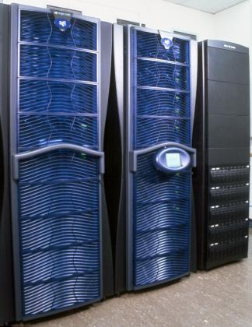
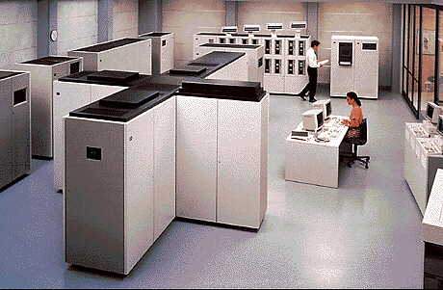
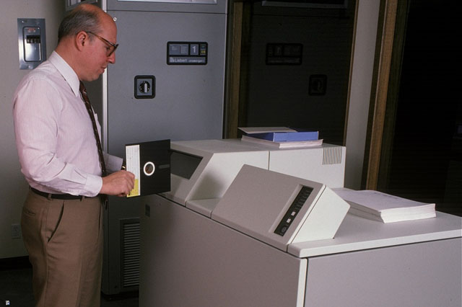
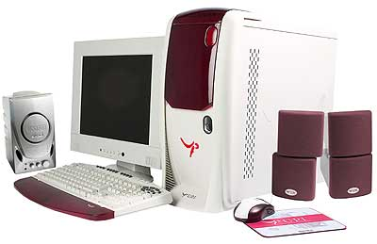
Classification by size / capacity

Slide 20
Classification by types
There are 3 types of computers
Analog,
Digital and
Hybrid.
This classification is done based on the manner in which the data are computed.

Slide 21
ANALOG COMPUTERS
Perform computations by setting up physical situations that are analogous to mathematical situations.
Temp: compute temp from how mercury rise up
Speed: compute speed from how fast wheel rotates
Calculate by measuring the continuous varying physical quantity such as pressure, temperature and speed.
Hence essentially measuring devices like speedometer, thermometer, voltmeters etc.
Have pointers for reading values anytime
Output is often in the form of smooth graph form which information can be read.

Slide 22
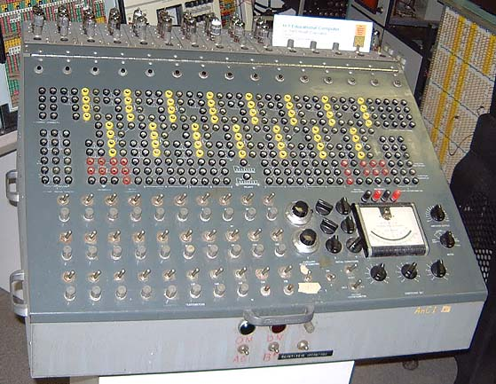
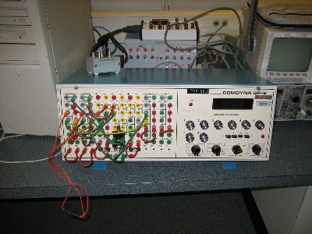
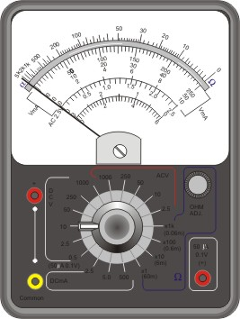
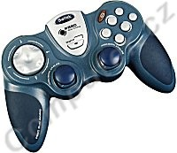
EXAMPLE OF ANALOG COMPUTERS

Slide 23
DIGITAL COMPUTERS
Basically counting devices.
Solves problems by counting precisely, adding, subtracting, multiplying, dividing and comparing.
The most common computer used in data processing environments.
Since most business data are in discrete form, it is readily adaptable to business data processing applications.
In digital computers numbers are used, there are no measurements.
Data in digital computers change in discrete steps
Accuracy obtainable from a digital computer is theoret­ically unlimited

Slide 24
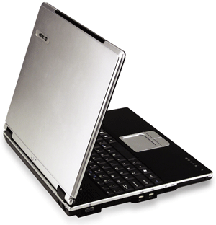
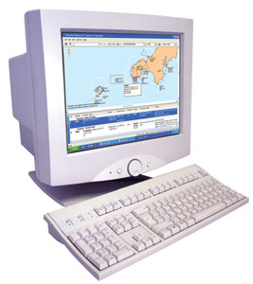
DIGITAL COMPUTERS

Slide 25
HYBRID COMPUTERS
Are both analog and digital,
Hybrid computers combine analog and digital capabilities in the same computer system.
This type of computer usually finds application in the industries.

Slide 26
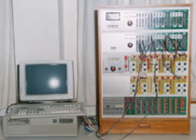
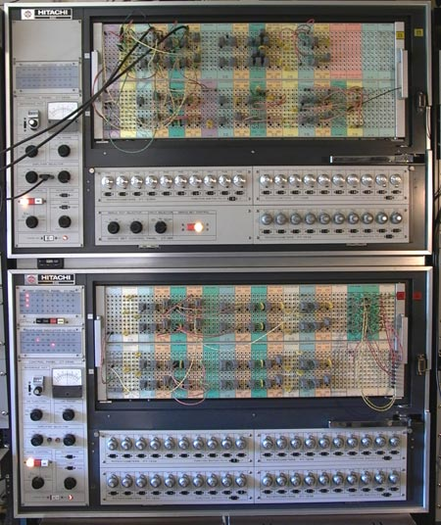
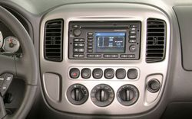
HYBRID COMPUTER

Slide 27
Basic PC Architecture
A PC system comprises of hardware (physical) and software (logical) components.
Hardware may defined as the physical part of the computer.
For example, the system unit or case , the processor, motherboard, power supply, disks, disk drives,
all associated equipment or 'peripherals' and
any of the physical electronic components belonging to the computer system.
Software is defined as the instructions or code that tell the computer what to do.
For example, a program that may be executed by the computer and
a Software is designed to ensure that the computer performs the required tasks to produce specific results.

Slide 28
Types of Computer Systems
All computers are systems of input, processing, output, storage, and control components.
Three basic categories
Mainframe
Midrange computers
Microcomputers

Slide 29
Type | CPU | RAM | Size
Supercomputer | 60billion to 3t | 8000MB+ | A small car
Mainframe | 500-4,500MIPS | 256-4096MB | refrigerator
MidRange | 250-1000MIPS | 256-2048MB | File cabinet
Server | 100-500MIPS | 256-1024MB | Fits on desktop
Workstation | 50-250MIPS | 128-1024MB | Fits on desktop
Microcomputer | 10-100MIPS | 64-512MB | Fits on desktop
Network computer | 10-30MIPS | 8-64MB | Fits on desktop
PDA and Cell Phone | ? | ? | ?

Slide 30
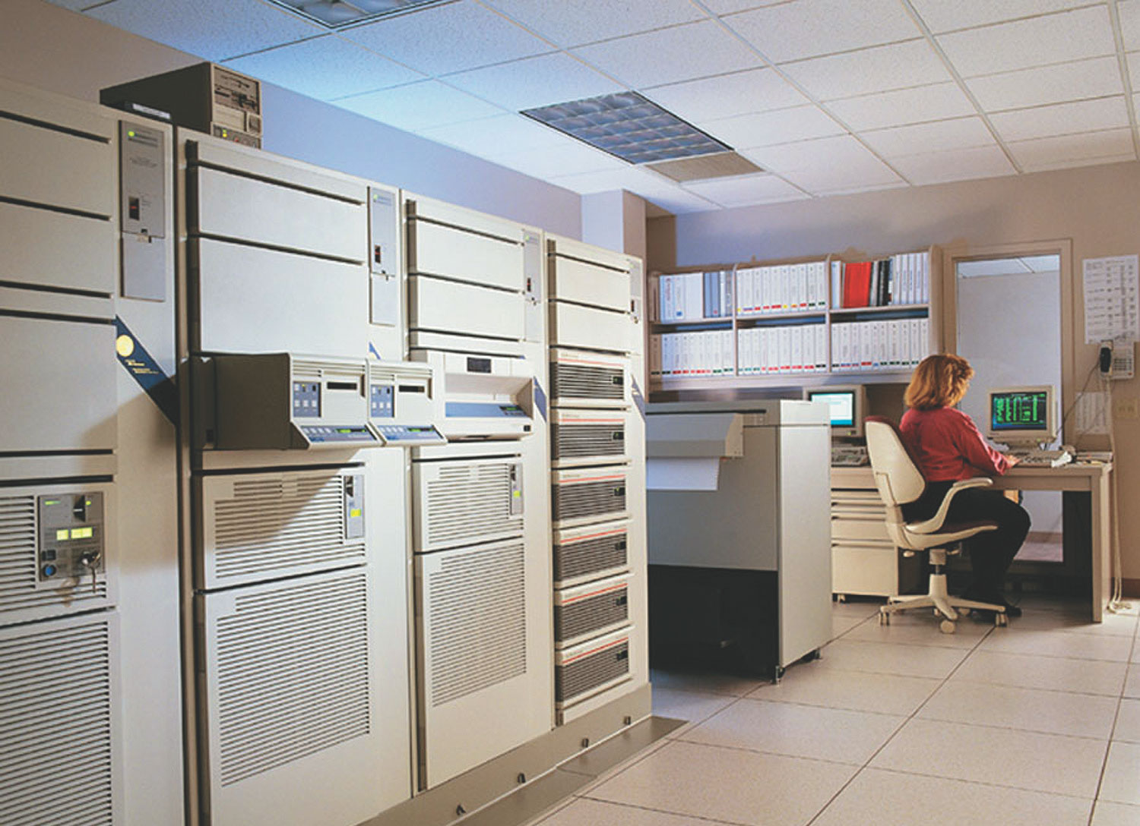
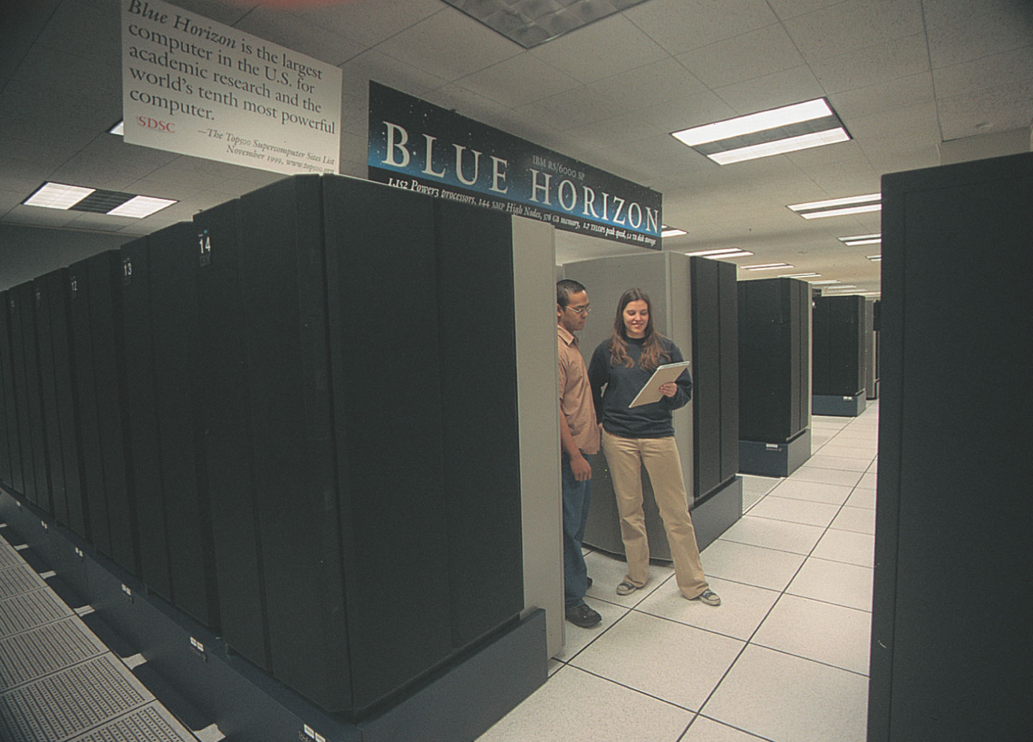
Mainframe
Enterprise systems
Superservers
Transaction processors
Supercomputers

Slide 31
Mainframe
Large, fast, powerful
Handle high transaction processing volumes or complex computational problems
Superservers for large client/server networks and high-volume Internet websites
Popular for data mining and warehousing
Supercomputers
Extremely powerful systems specifically designed for scientific, engineering, and business applications requiring extremely high speeds for massive numeric computations
Use parallel processing architectures
Process at speeds measured in gigaflops and teraflops

Slide 32
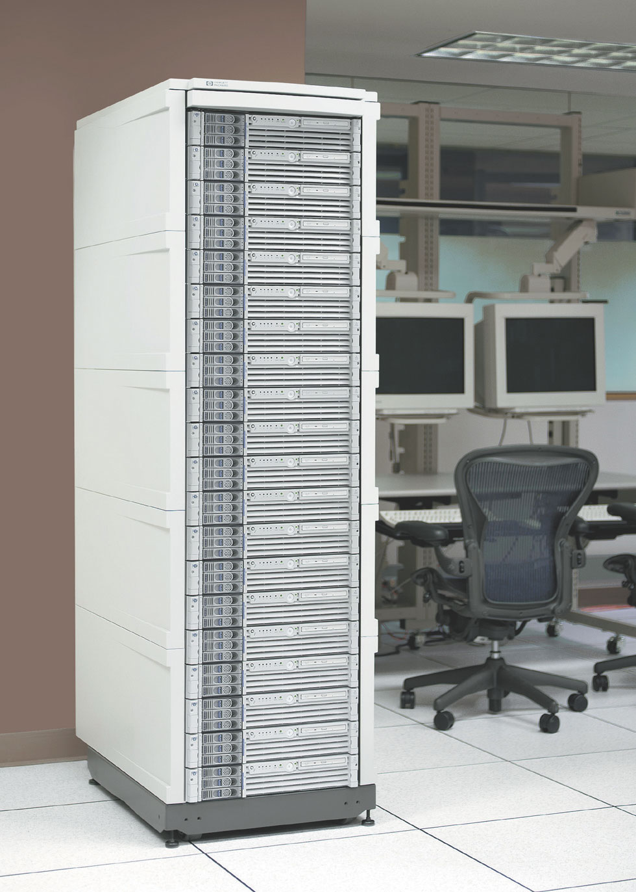
Midrange
Network servers
Minicomputers
Web servers
Multi-user systems

Slide 33
Midrange
Multi-user systems that can manage networks of PCs and terminals
Less costly to buy, operate, and maintain than mainframes
Popular as network servers
Minicomputers

Slide 34
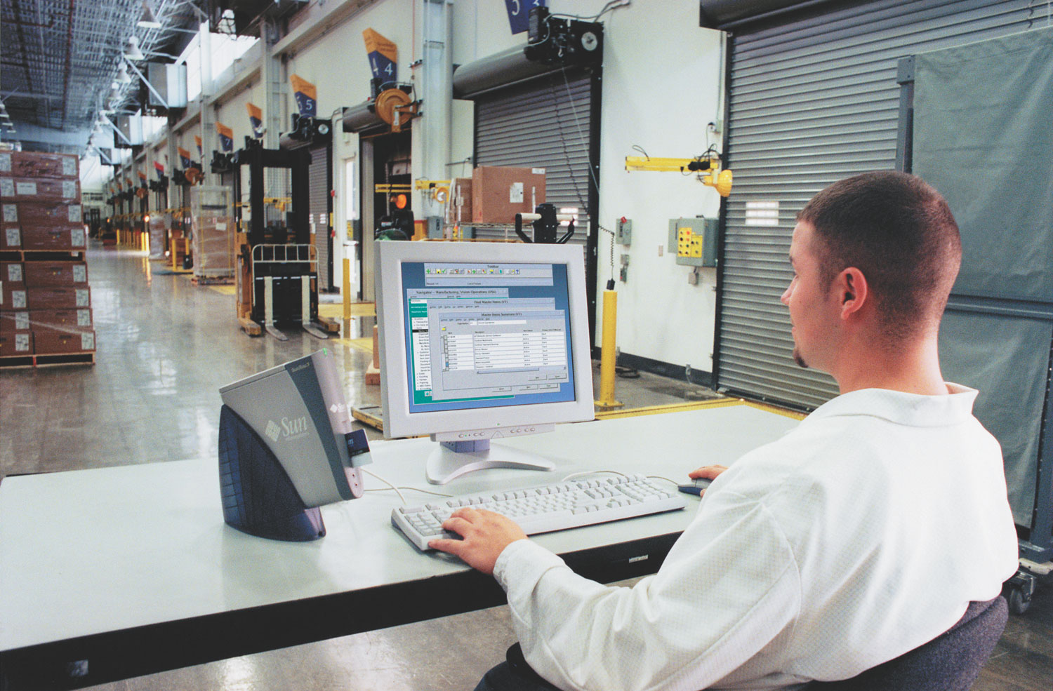
Microcomputers
Personal computers
Network computers: thin client
Workstations: powerful for CAD, graphics or mathematical computing
Terminals: Dumb terminals, Intelligent terminals, Network terminals, Transaction terminals
Information appliances: PDAs, PCS, Cellphone, Wireless

Slide 35
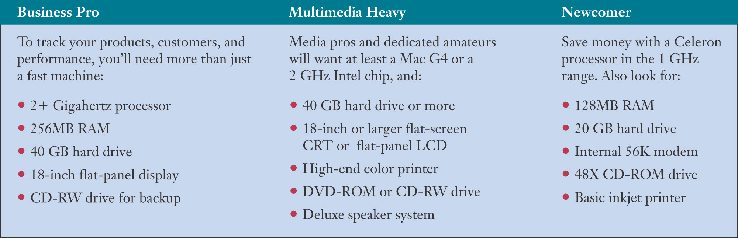
Microcomputers
Selection criteria
Solid performance at a reasonable price
Operating system ready
Connectivity

Slide 36
Computer in society

Slide 37

Computers in Society & in your Career
Computer careers in:
Business
The Arts
The Medical Field
Law Enforcement
Legal Fields
Education
The Sciences
Gaming
Homes
Notes:
Regardless of which profession you pursue, if computers are not already in use in that career, they most likely will be soon.
The U.S. Department of Labor predicts that by 2010, 70 percent of the U.S. workforce will be using computers at work.
Meanwhile, the U.S. Department of Agriculture has found that employees who use a computer on the job earn about 10 percent more than those who don’t.
Becoming truly computer fluent—understanding the capabilities and limitations of computers and what you can do with them—will undoubtedly help you perform your job more effectively.

Slide 38
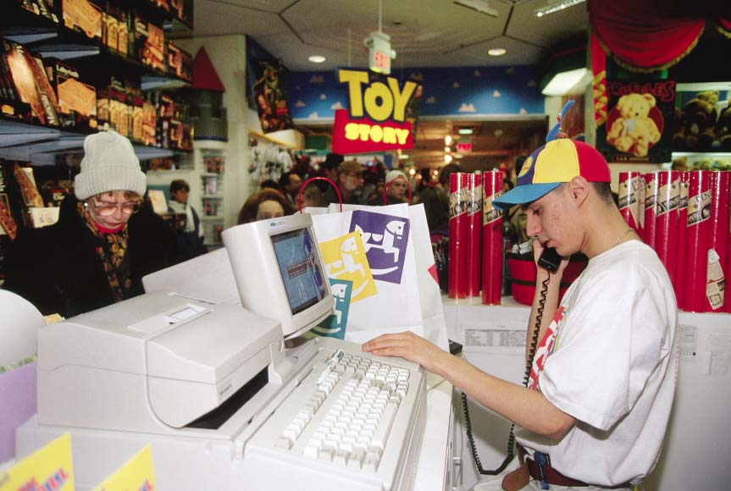
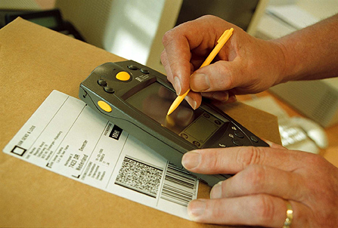
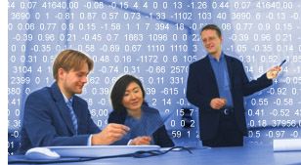
Computers in Business
Point of Sale Terminals
Tracking merchandise
Data mining
Notes:
Business around the world is conducted on the computer screen. Information is stored in enormous databases. To make meaning of all that data, they use a process known as data mining.
Enormous leaps in business productivity are a direct result of the use of computers in all phases of business, from communications to product design. For example, the cash register is now a point of sale terminal. that connects automatically to a database, providing managers with current data on sales. This allows for better tracking of merchandise.
Every segment of business has been transformed by the computer.

Slide 39
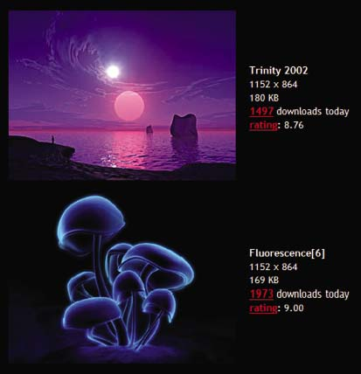
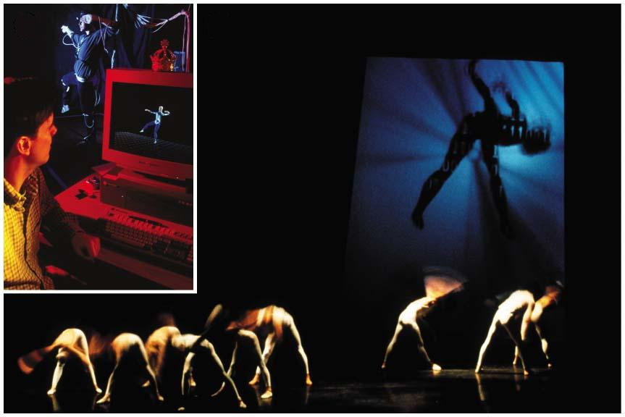
Computers in the Arts
Virtual art
Virtual dance
Notes:
The creative arts have been widely enhanced by computers. Artists communicate and collaborate across oceans. Writers and editors complete their work together from across the country. New forms of graphic arts and cinematography are introduced every day, all globally and immediately. Even dance has been enhanced with the computer.

Slide 40
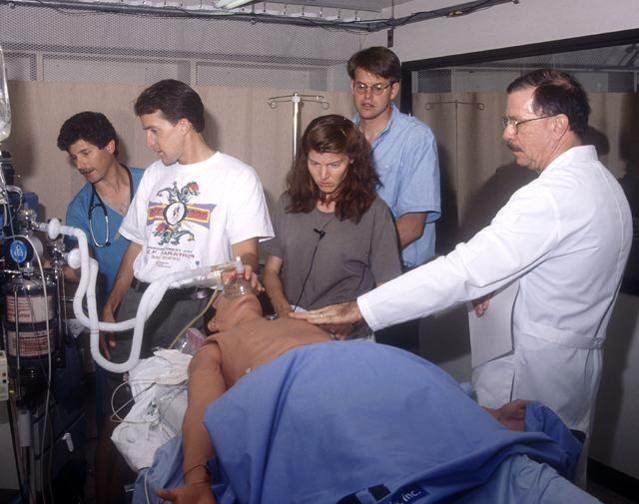
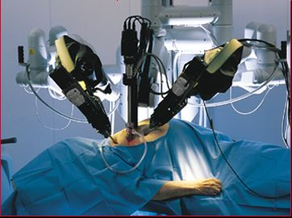
Computers in the Medical Field
Virtual reality in medical applications
Patient simulator
Da Vinci Surgical System
Notes:
Few fields have grown as fast and touched our lives more than modern medicine. The ability of the computer to store, process, and distribute vast amounts of information globally and immediately has led to tremendous breakthroughs in pharmaceuticals and disease prevention. People are living longer, healthier lives and computers have played a large part in this development.
Medical professionals can now train on patient simulators without risking a patient’s life.
In the Physiome Project bioengineers are creating realistic computer simulations of all systems and features of the human anatomy.
Surgery is being performed with robotic equipment.

Slide 41
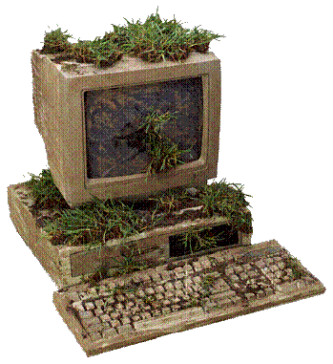
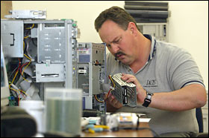
Computers in Law Enforcement
Computer forensics
Notes:
Law enforcement uses computers to quickly find records, locate possible suspects, and investigate accounts. As the Internet and e-commerce become more and more popular, criminals stalk the wire for victims. Law enforcement officers must use computers to track and capture criminals.
Computer forensics is the application of computer systems and techniques to gather potential legal evidence.
Even parking enforcement uses technology today

Slide 42
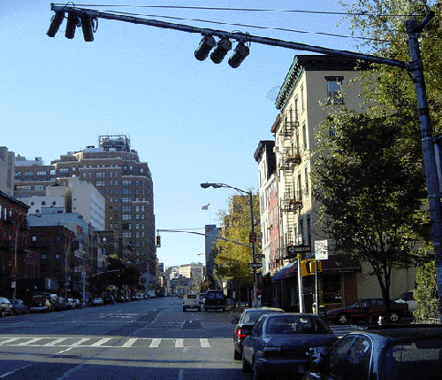
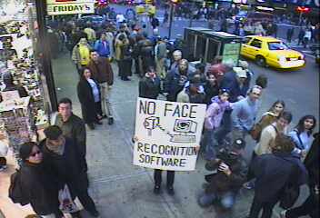
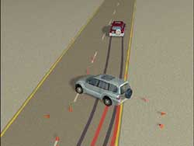
Computers in the Legal Fields
Surveillance cameras
Forensic animation
Notes:
Computers have changed the way the government interacts with the public. Records, laws, and transactions in electronic form are common and have increased the speed and usefulness of legal information. From the cop who can run a license plate number in seconds to the income tax form filed electronically, the computer has had an enormous effect on the law.
Surveillance cameras watch over us constantly, snapping a picture when we run a red light. In court, animators make animated movies of events the way things probably happened, bringing to the screen a far clearer picture than mere testimony would provide.

Slide 43
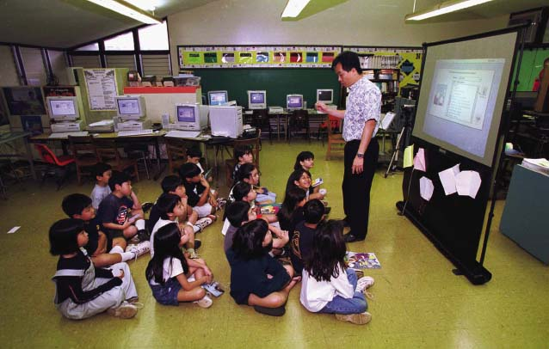
Computers in Education
Computers in the classroom
Distance Education
Computerized research
The Internet
Notes:
Computers have given teachers tremendous new tools for presenting information and keeping records.
Colleges offer full degree programs, totally over the Internet.
Vast stores of information are available wherever there is an Internet connection. Libraries have brought the computer into their operations. Training tutorials are used to teach new tasks and research is done from the desktop. Education will never be the same as it was..

Slide 44
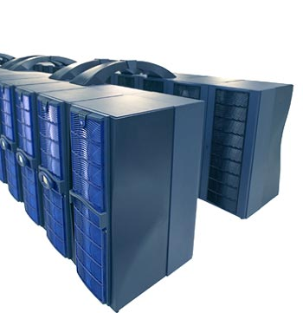
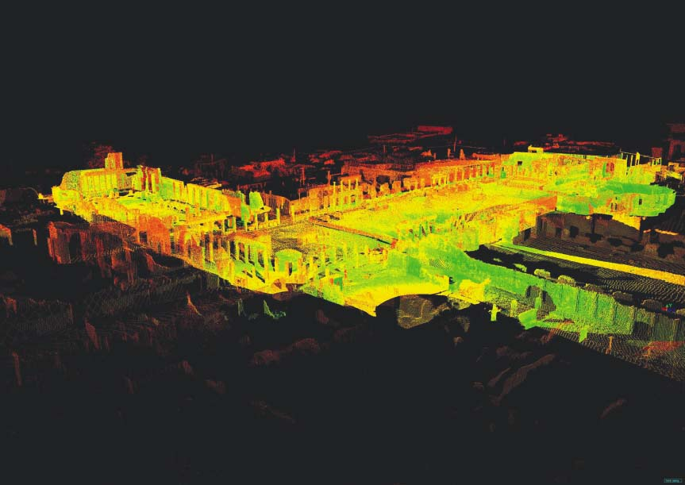
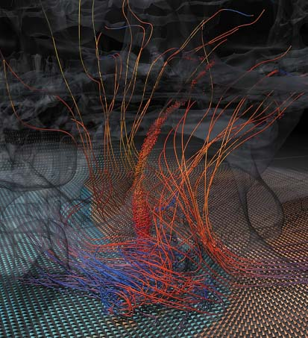
Computers and the Sciences
Supercomputers
Archeology
Meteorology
Notes:
Science has used the computer to streamline studies, eliminate redundancy, test hypotheses, develop theories, and communicate findings. The computer has brought vast new levels of global collaboration, advancing fields like engineering, chemistry, physics ,and cosmology to unprecedented levels.
Supercomputers crunch enormous amounts of data carrying out experiments that could not be done before. Storms are being studied through intricate application of known data to form pictures that increase understanding.
3D modeling and imagine software is helping archeologists take data and simulate ancient civilizations.

Slide 45
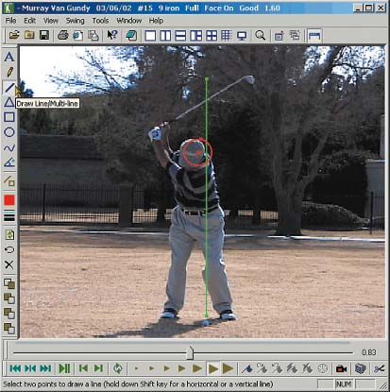
Computers in Sports
Training
Timing and scorekeeping
Data storage and statistics
Notes:
Watch an auto race and look at the computers in the pits. Coaches in football use computers constantly. Officials use them to control games. Computers are used to analyze performance and optimize training. The use of computers at the Olympic Games is legendary.

Slide 46
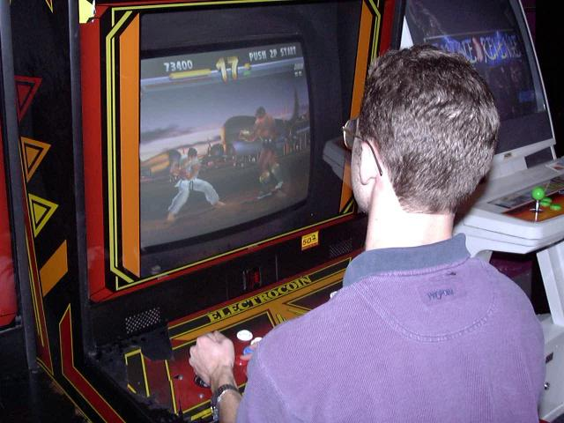
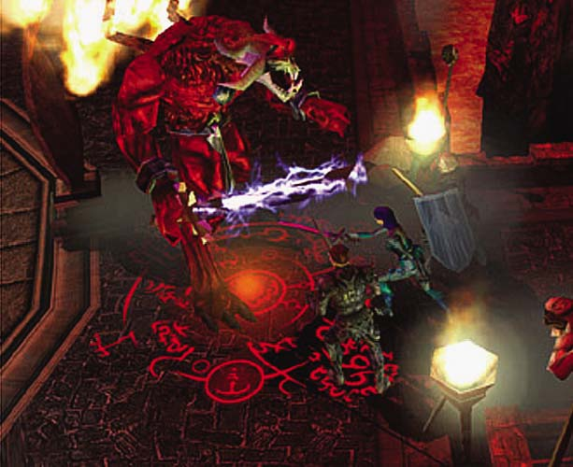
Computer Gaming Careers
Programming
3D animation
Notes:
The computer and video game industry is enormous. In fact, revenues from computer gaming in the United States have surpassed revenues from Hollywood. Very intricate programming is behind these games. The animations are the result of years of research and development, with new games being developed everyday

Slide 47
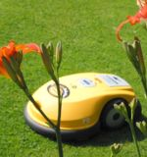
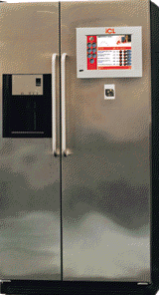
Computers at Home
Robotics
Smart appliances
Internet-connected refrigerator
Robomower
Notes:
Already, robotic vacuums and lawnmowers are on the market.
The home of the future promises smart appliances that connect to the Internet. The wired home will converge with the computer, television ,and telephone to totally surround us with devices programmed by our needs and desires.

Slide 48
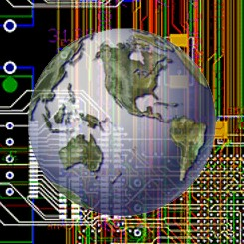
Technology of Tomorrow
Nanoscience
Biomedical Chip Implants
Artificial Intelligence
Notes:
Nanoscience involves the study of very small structures.
Tiny biomedical chip implants can electronically monitor and transmit our health.
Everyday computers are able to make more and more decisions on their own, a field called artificial intelligence. It truly is a brave new world.

Slide 49
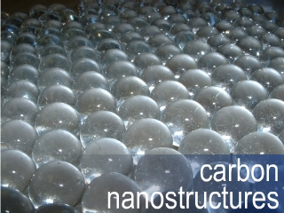
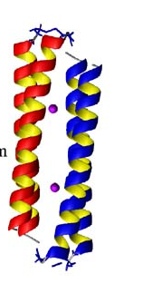
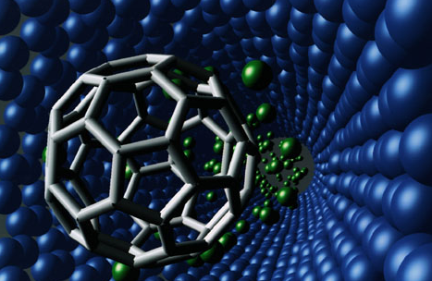
Nanoscience
Molecules and nanostructures
Nanomachines
Fluid flow inside Nanomachines
5.4nm
Four-α-helix protein scaffold
Notes:
Nanoscience involves the study of molecules and structures (called nanostructures) whose size ranges from 1 to 100 nanometers. Nanotechnology is the science revolving around the use of nanostructures to build devices on an extremely small scale.
Working at the molecular level, scientists have built microscopic machines that perform assigned tasks. New materials and processes are emerging in this exciting new field of discovery.

Slide 50
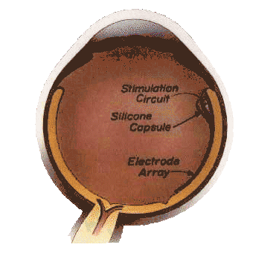
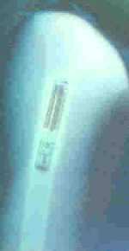
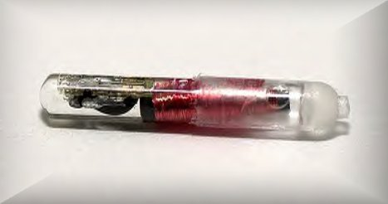
Biomedical Chip Implants
Technological solutions to physical problems
Identity chips
Retinal Implants
VeriChip
Notes:
Electronic implants are replacing damaged nerves. They are being embedded as identification devices that can be scanned to prove a person is who he says he is. They are being implanted in children so as to locate them if they are abducted. These implants can give doctors a remote sensor inside the body, monitoring systems for problems and catching them before they are out of control.

Slide 51



Artificial Intelligence
Robots
Neurons vs Microchips
Notes:
Can computers think? The field of artificial intelligence shows us that they can make decisions based on criteria. As long as the facts are clear and the computer has a system to evaluate those facts, it can decide between alternatives.
A good example is how well computers play chess. The best computer plays the best human to a draw. However, the computer is less prone to make a mistake.
If a question requires creativity or dynamic thinking, the human brain’s neural network can’t be matched. It is so complex that science is just beginning to understand how it works.

Slide 52

Challenges Facing a Digital Society
Privacy risks
Personal data collection
Monitoring e-mail
Copyright infringement
Software piracy
Notes:
The information age brings to each of us a set of unprecedented challenges. Our identity can be stolen. Our work e-mails may be viewed. Otherwise law-abiding citizens illegally copy software. Without thinking ,we cut and paste from copyrighted material on the Web.
As computers become more and more embedded in our lives, all of these challenges will grow. Making the personal decisions required to efficiently, legally, and safely maneuver through cyberspace is tied to the knowledge and awareness of the user.

Slide 53
READ, READ NOW

